Slide 1
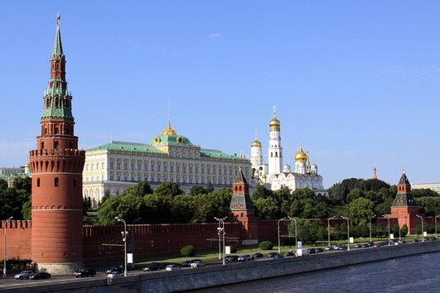
The Moscow Kremlin
THE WORD “KREMLIN” MEANS fortress in Russian. The most famous and well-known is the Moscow Kremlin. It is a large, walled area in the heart of Moscow. The Kremlin is built next to the Moscow River on one side and Red Square on the other. Inside, there are beautiful palaces, churches and cathedrals, as well as various other attractive state buildings, tree-lined squares and peaceful gardens.
Shramko Alexnader and Zaguryanova Yana
Form 10-B

Slide 2
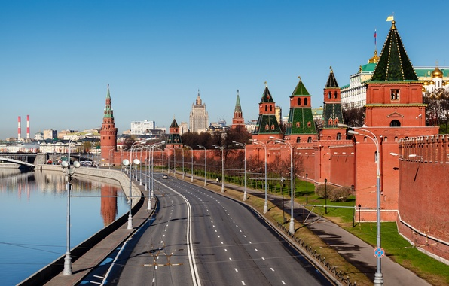
The wall around the Moscow Kremlin is 2,235 metres long and five to nineteen metres thick. There are twenty towers that look out over the city in every direction. Spasskaya Tower is 71 m tall and is the main tower that looks out over Red Square.

Slide 3
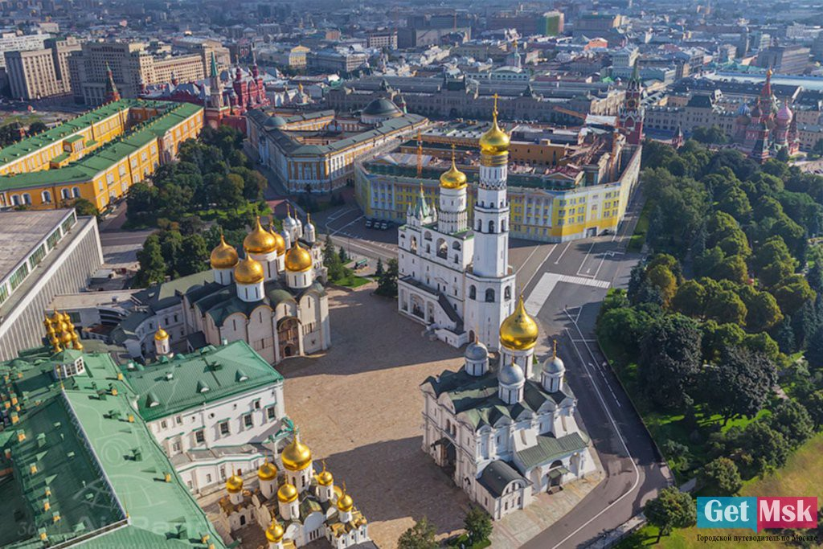
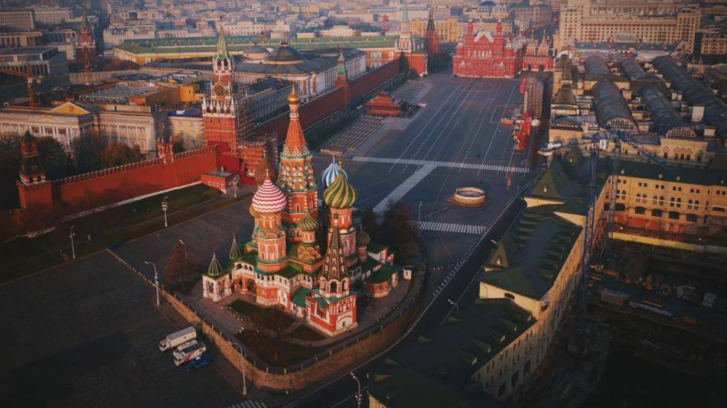
The Moscow Kremlin and Red Square were designated a UNESCO World Heritage site in 1990. This is not surprising when you discover how many incredibly beautiful churches and palaces there are. For example, in Cathedral Square there are three magnificent cathedrals from the late 15th and early 16th centuries. The Cathedral of the Assumption is the oldest. It is made of white stone and has five golden domes. Many Orthodox patriarchs are buried there.

Slide 4
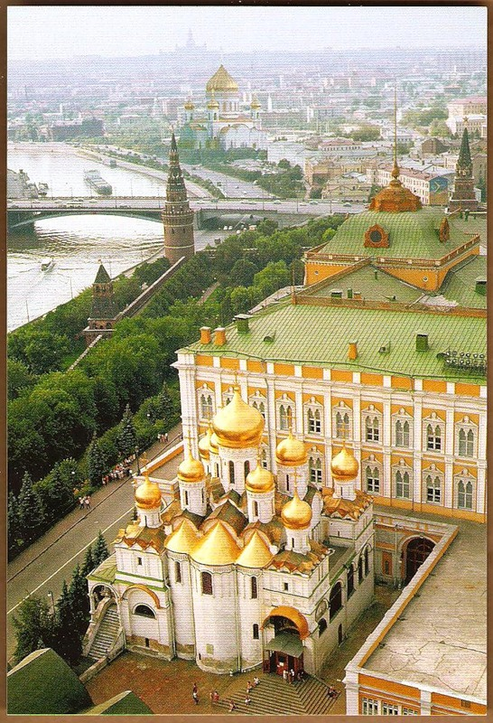
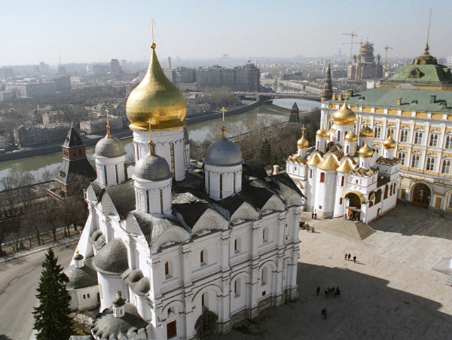
Across the square is the Cathedral of the Annunciation, which also has golden roofs and domes. Inside there are some early 15th-century icons by Theophanes and Andrei Rublvov. Then, there is the Cathedral of St Michael the Archangel where the princes of Moscow and the tsars of Russia are buried.

Slide 5
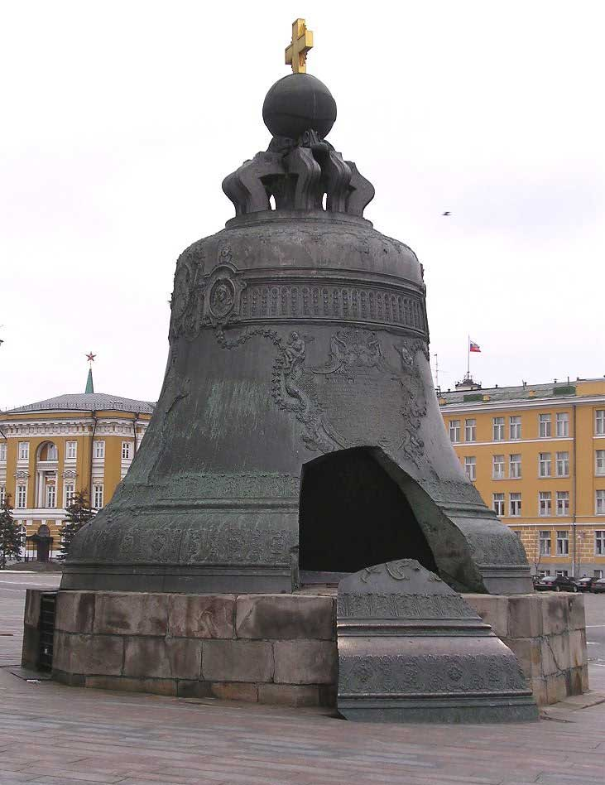
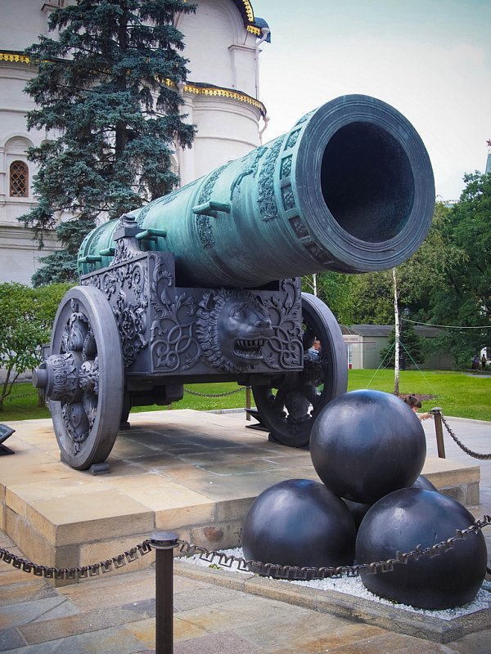
Next to the square is the white bell tower of Ivan 111 and at the bottom is the huge Tsar Bell which was made in 1733-35 but has never been mng. Then close by is the Tsar Cannon which dates from 1586 and stands next to the mid-17th-century Cathedral of the Twelve Apostles and the Patriarchal Palace.

Slide 6
Thanks for watching!
Shramko Alexnader and Zaguryanova Yana

